Slide 1


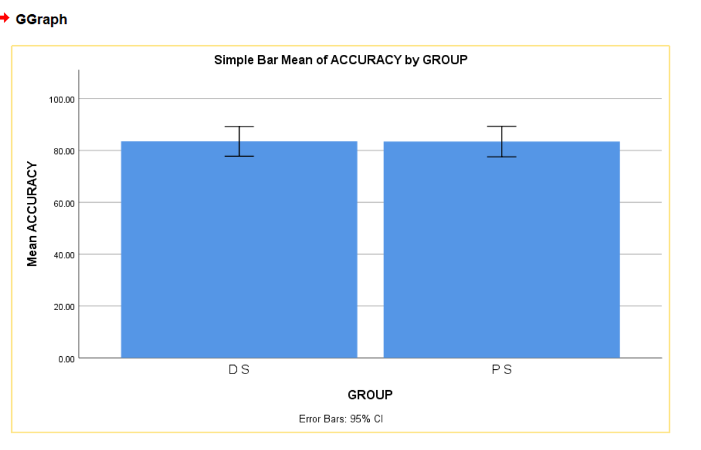
Name: Mr. V.VAMSI Register Number: 192212079
Guided by Dr. R.DINESH KUMAR
Ms. Poorani.S
Guided by Dr. Mary Valantina. G
Task management system
INTRODUCTION
In today's fast-paced world, effective task management is crucial for individuals and organizations alike. Introducing our cutting-edge task management system, meticulously crafted to seamlessly transition between priority scheduling.
At the heart of our system lies a sophisticated priority scheduling algorithm,This enables users to focus their efforts on high-priority tasks while maintaining a clear understanding of upcoming deadlines.
We understand that meeting deadlines is equally essential in today's competitive landscape. That's why our task management allowing users to set, track, and manage deadlines with ease.
The flexibility of priority scheduling and the reliability of deadline management. Say goodbye to the stress of missed deadlines and the chaos of disorganized task lists.
Experience the power of seamless prioritization and deadline management with our Priority to Deadline Task Management System.
MATERIALS AND METHODS
Feasibility businessstudy
Data Collection/
Pre -Processing
Deadline scheduling
Model deployment and END
Functional Model
Implementation
Feature Extraction/Algorithm
Priority scheduling
Model training/
Model evaluation
Design and Build
TASK MANAGEMENT SYSTEM ALGORITHMS
RESULTS
 | Algorithm | N | Mean | Std. Deviation | Std. Error Mean
Accuracy | Priority Scheduling | 10 | 83.4000 | 8.24891 | 2.60853
 | Deadline Scheduling | 10 | 83.5000 | 8.01734 | 2.53531
In the present work, priority scheduling (PS) is compared with deadline scheduling(DS) and it depicts that the proposed algorithm gives more accuracy when compared with the priority scheduling. Deadline scheduling outforms in task management system by better handling binary outcome prediction and proving more accurate classification.
DISCUSSION AND CONCLUSION
Based on T-test Statistical analysis, the significance value of p=0.95 (independent sample T - test p>0.05) is obtained and shows that there is a statistical significant difference between the group 1 and group 2.
Overall , the accuracy of the priority scheduling (PS) is 50.00 % and it is better than the other algorithm.
Deadline Scheduling(DS) - 33.33%
From the work , it is concluded that the priority scheduling algorithm attains the high accuracy when comparing with other deadline scheduling Algorithm of task management system.
In priority scheduling, deadline scheduling offers superior classification performance for binary outcome compared to deadline scheduling suitability for continuous outcome prediction.
Priority scheduling allows for greater flexibility in task execution, as it considers factors beyond just deadlines.
BIBLIOGRAPHY
Android Studio 2 Development Essentials, Book by Neil Smyth.
PHP and MySQL Web Development, Book by Luke Welling, 2001.
D. A. Hillson, "Using a Risk Breakdown Structure in project management", Journal Of Facilities Management, vol. 2, no. 1, pp. 85-97, 2013.
A. Aleshin, "Time and Risk Management of International Projects", International Journal of Project Management, no. 19, pp. 207-222, 2014.
J. Ellis, L. Kvavilashvili, "Prioritization of tasks in 2000: Past present and future directions", Task Management, vol. 14, pp. 1-9, 2000.
Cohen Kashi S., Rozenes S. & Ben-Gal, I. (2016). “Project Management Monitoring Based on Expected Duration Entropy” (PDF). In Entropy 2020, 22, 905.
G., Morris, Peter W. (1994). The management of projects. London: T. Telford. p. 317. ISBN 978-0727725936. OCLC 30437274.
Graham, Robert J., and Randall L. Englund. Creating an Environment for Successful Projects. San Francisco: Jossey-Bass, 1997.
J.A. Zarnan, Numerical solution of Volterra integral equations of Second Kind. Int. J. Comput. Sci. Mobile Comput., 5(7), 509-517, (2016).
J.A. Zarnan, A novel approach for solving a class of Urysohn integral equations using Bernstein polynomials. Int. J. Adv. Res., 5(1), 2156-2162. (2017).

